Slide 1
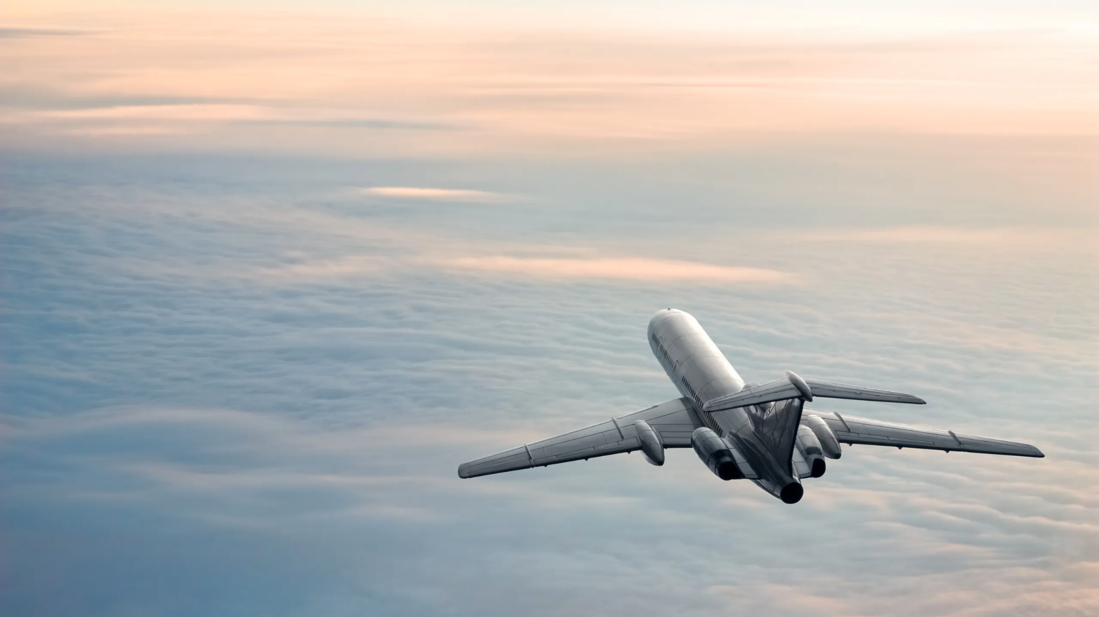
Flight Analysis
Yang Liu, Junrui Wan,
Linghao Yang, Curtis Zhuang
Dec. 11th, 2021

Slide 2


Background & Business Objectives
EDA
Modeling
Model Comparison
Conclusion
Future Study
Contents

Slide 3
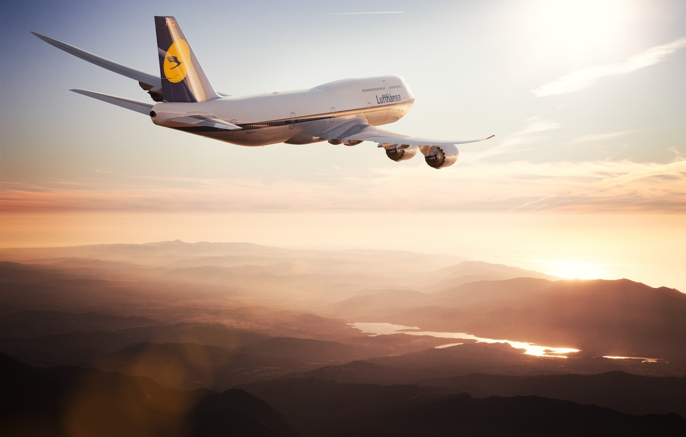
Background and Business Objectives

Slide 4

Problem Background
According to data from the U.S. Bureau of Transportation Statistics, nearly 20% of all U.S. flights arrived late, and 1.8% of them were canceled.

Slide 5
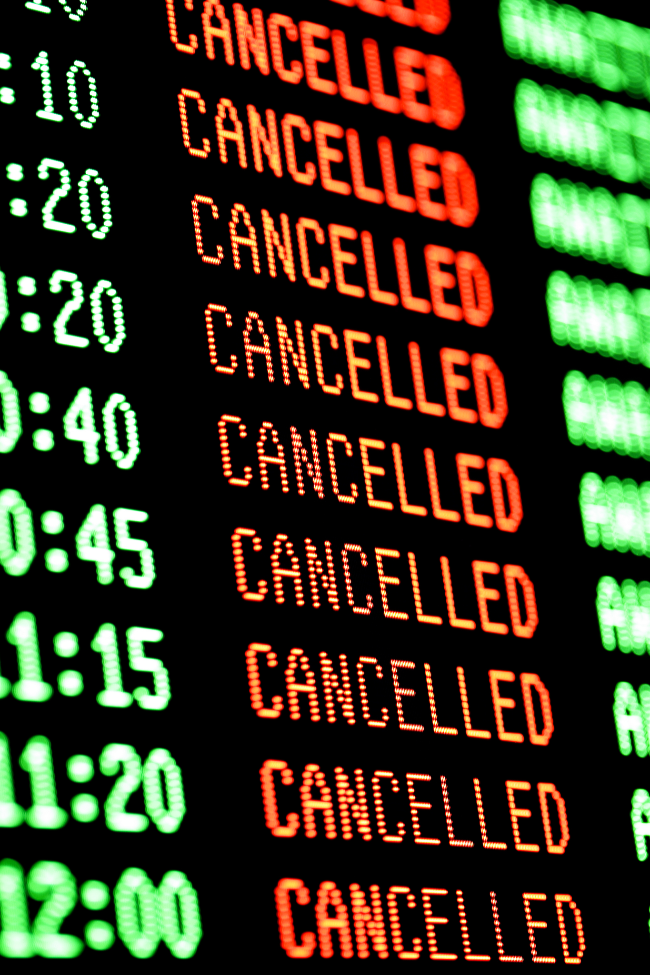
Business Objectives
Flight delay and cancellation are inevitable, and they are important to both customers and airlines.They not only irritate air passengers and disrupt their schedules but also cause a decrease in efficiency to airlines.
Our main goal is to find out the key factors that lead to cancellation and delay. Mitigating their significant economic and environmental impacts.

Slide 6
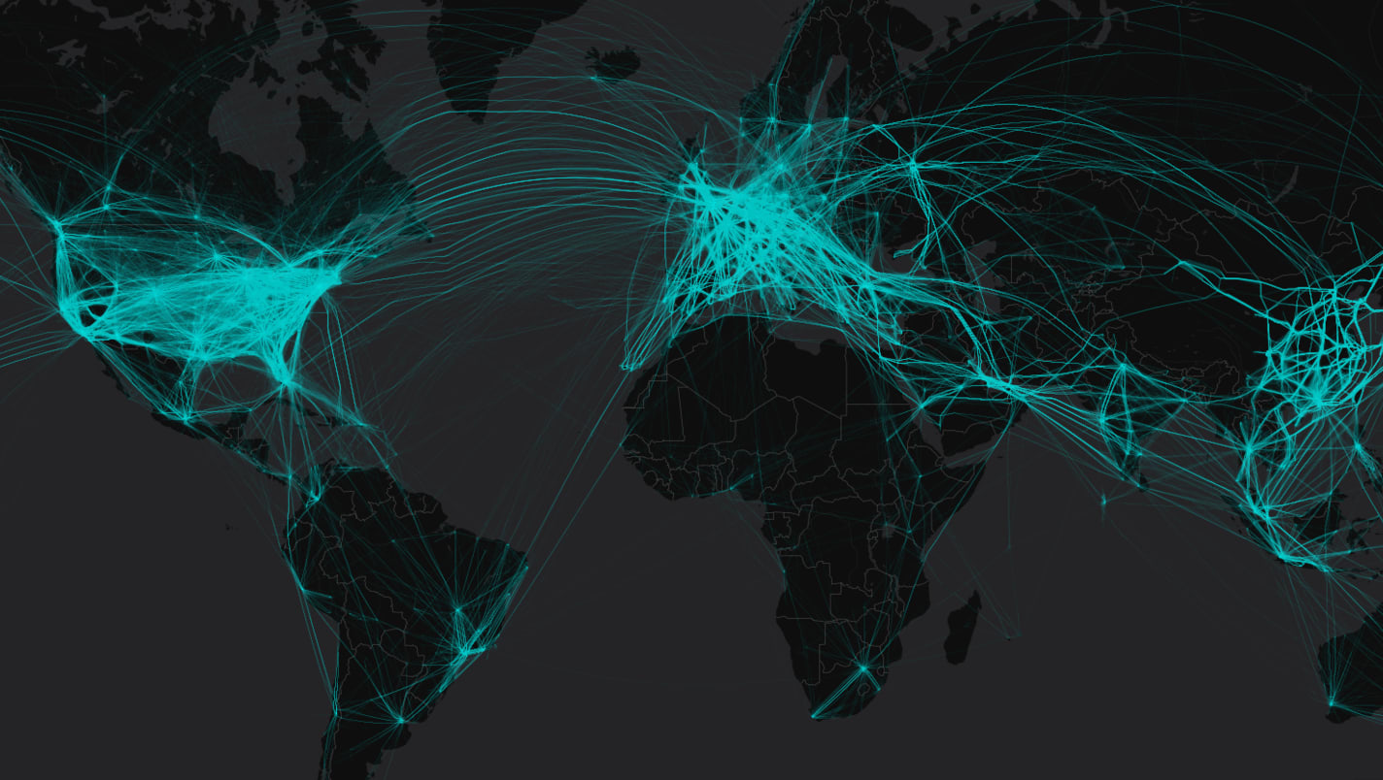
Exploratory Data Analysis

Slide 7
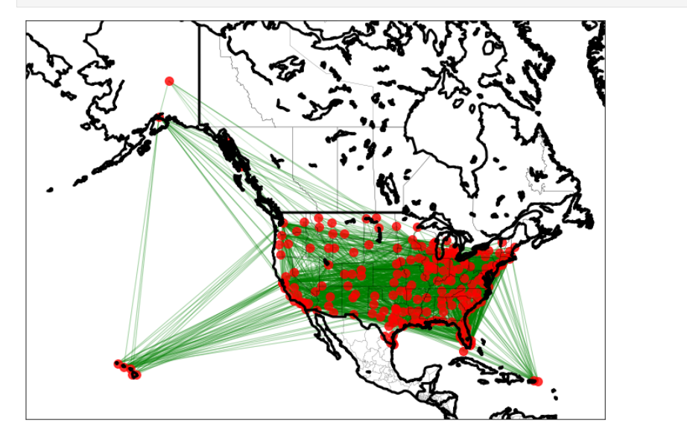
EDA
Flight arrival and departure details for all commercial flights within the USA
From October 1987 to April 2008
123,534,969 rows x 29 columns
21GB
Key variables:
Date
Origin, Dest
Distance
Cancelled
ArrTime, DepTime, CRSArrTime, CRSDepTime
Delay(Carrier, Weather, NAS, LateAircraft, Security)
Notes:
123534969

Slide 8
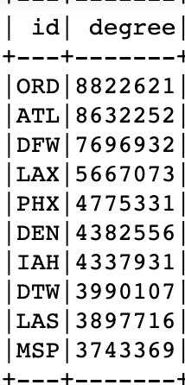
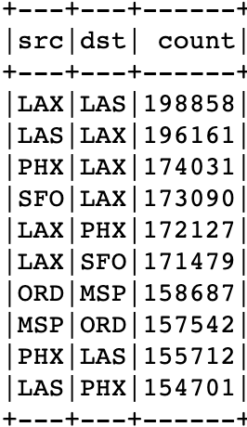
EDA - Flight Analysis
Busiest Airport: ORD, ATL, DFW
Busiest Airline: SouthWest, Delta, American
Busiest Time: 8 o’clock followed by 17 o’clock
Busiest Month: August, July, March

Slide 9
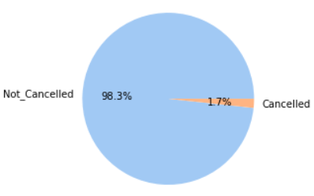
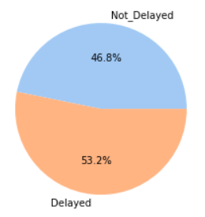
EDA
Most of the flights are not cancelled

Slide 10
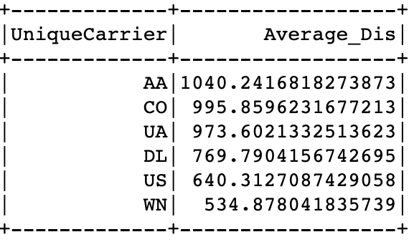
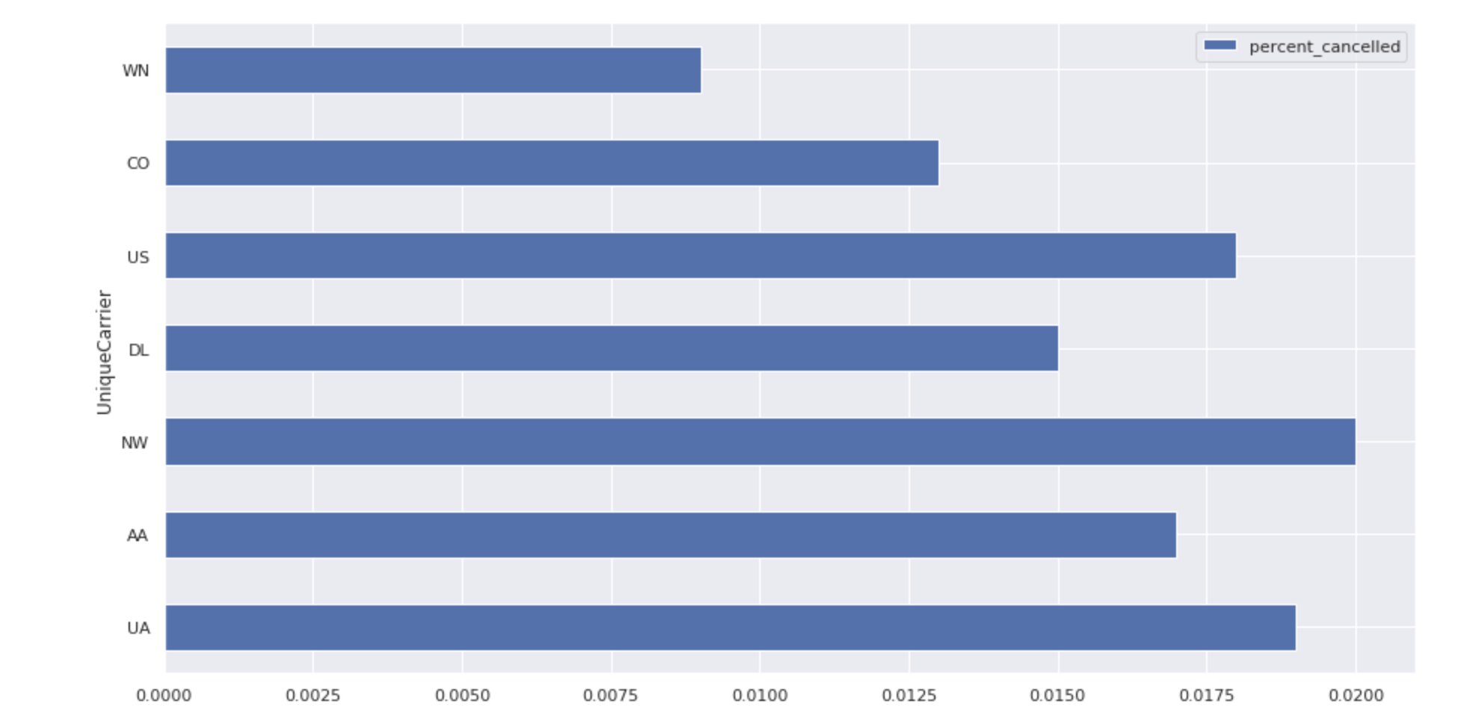
EDA - Cancellation Analysis - Carrier
Longer flights likely to get cancelled

Slide 11
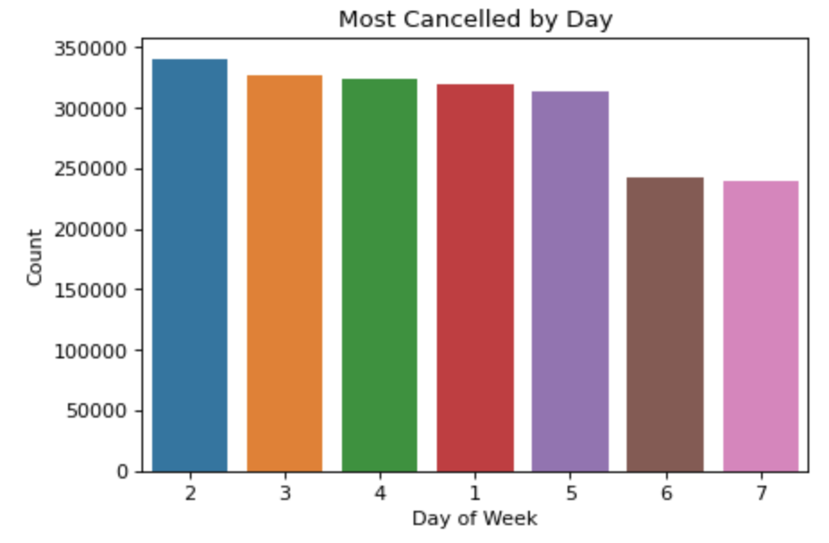
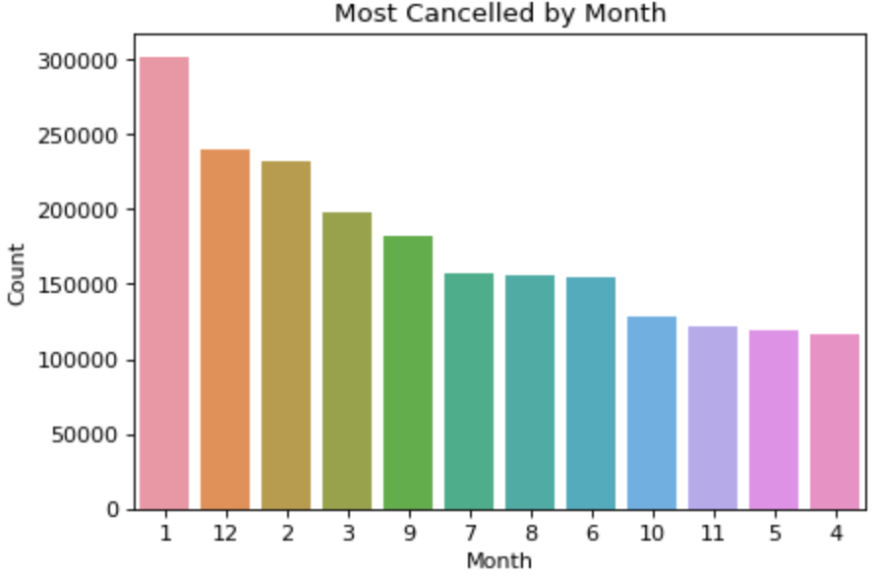
EDA - Cancel Analysis - Time
Most cancelled flights by Time:
Winter times sees more flight cancellations followed by summer
Week days sees more flight cancellations than weekends

Slide 12
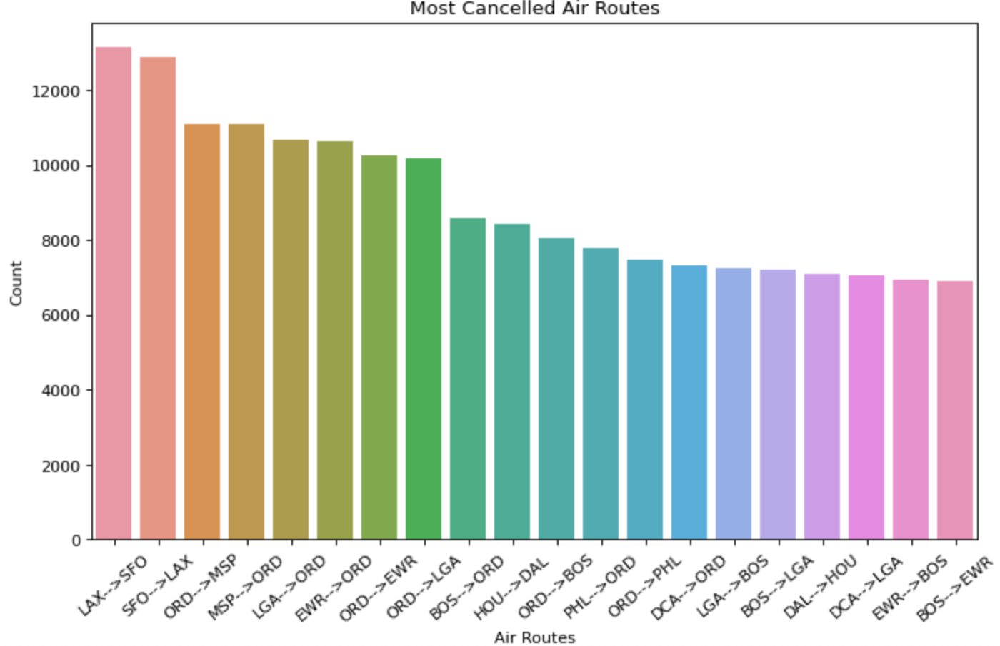
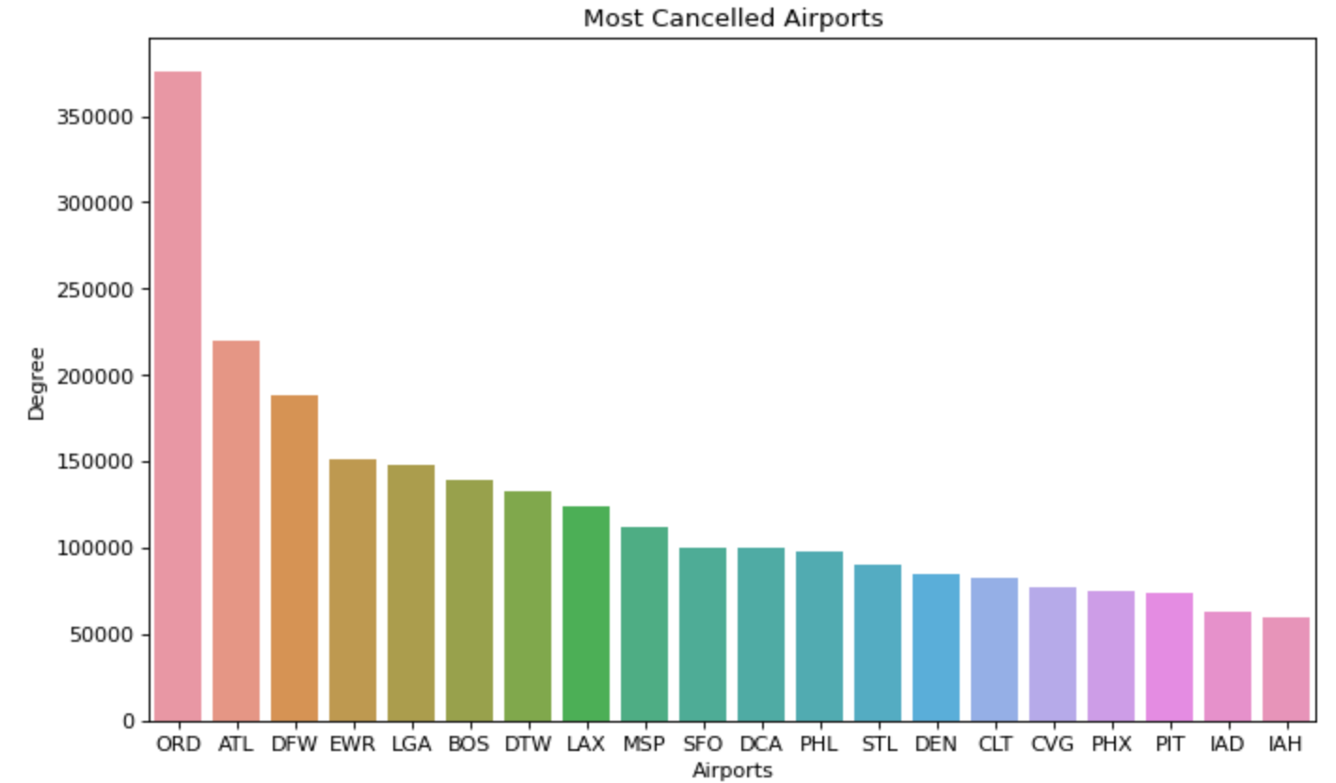
EDA - Cancel Analysis - Airport
Most cancelled flights by Airport:
LAX to SFO is most cancelled route both direction followed by MSP to ORD
ORD most cancelled airport followed by ATL
Flights cancellation are often bi-directional

Slide 13
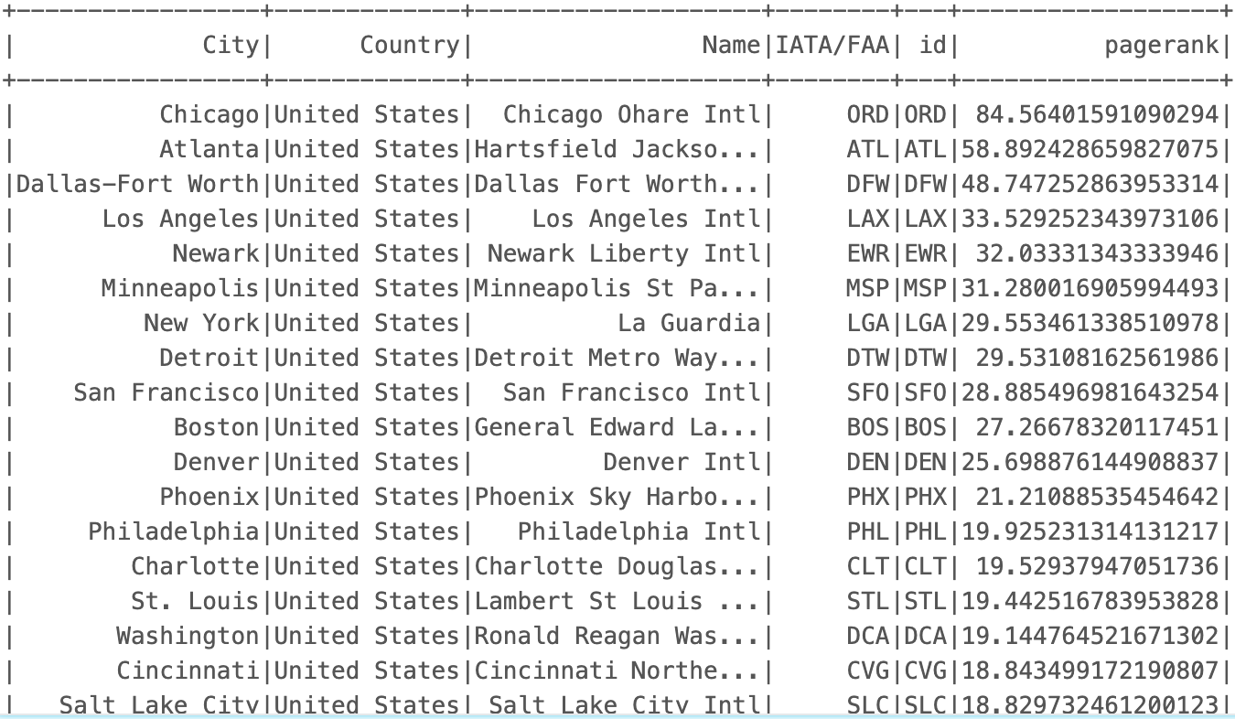
Cancellation Analysis - Page Rank

Slide 14
EDA - Cancellation Analysis
Cancelled flights make up 1.7% of total flights which is much larger than expected
ORD is the airport that receives most cancellations compared to others
Maybe due to weather
ORD is also the busiest airport based on analysis
Flights are more likely to be cancelled during Winter months followed by Summer
Flights are more likely to be cancelled during weekdays, especially on Tuesday
NorthWest, United, USAirways has highest cancellation, SouthWest sees the lowest

Slide 15
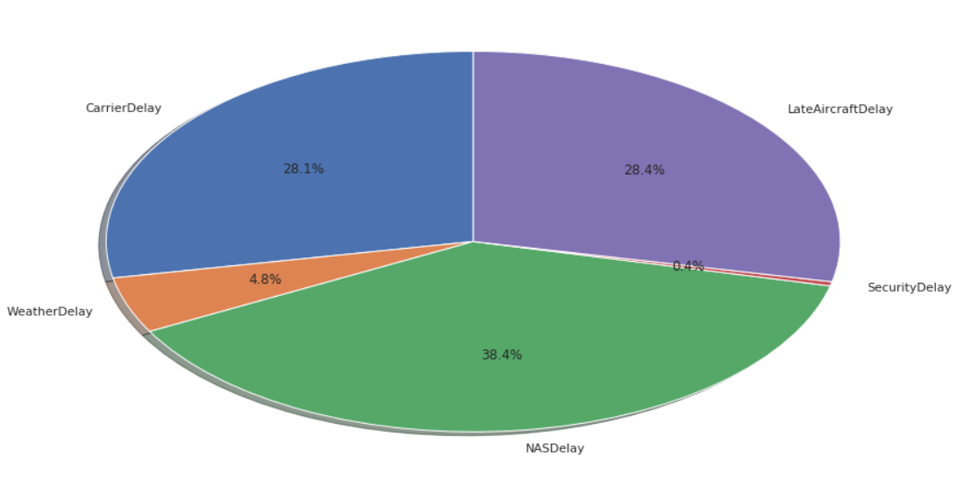
EDA - Delay Analysis
Most of the delay are NAS Delay, Late Aircraft Delay, and Carrier Delay
We will see how different delay reasons has different delay results

Slide 16
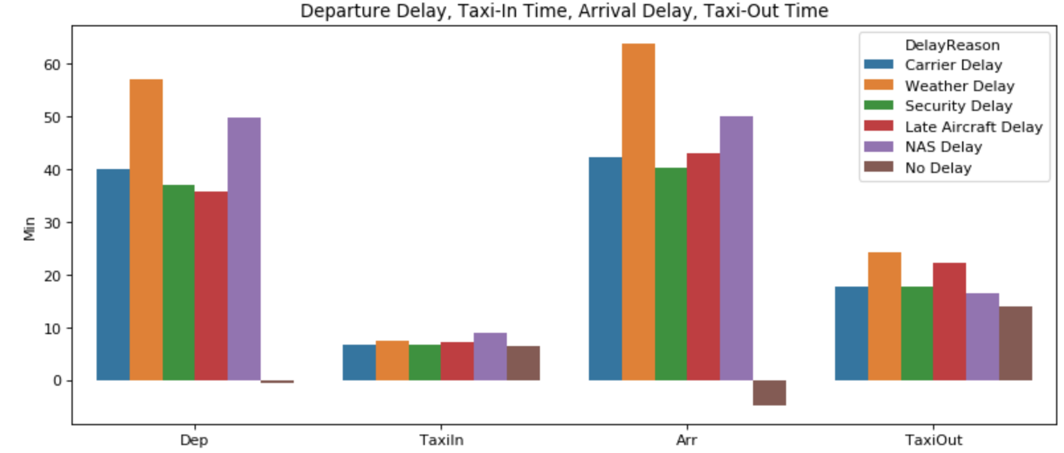
Delay Analysis - Delay Reason
When observing delay time on average, we see Weather leads to longest wait times
Weather also leads to longer time to Taxi-In and Taxi-Out compared with other delays
We will investigate further to see if delay types do make a difference

Slide 17
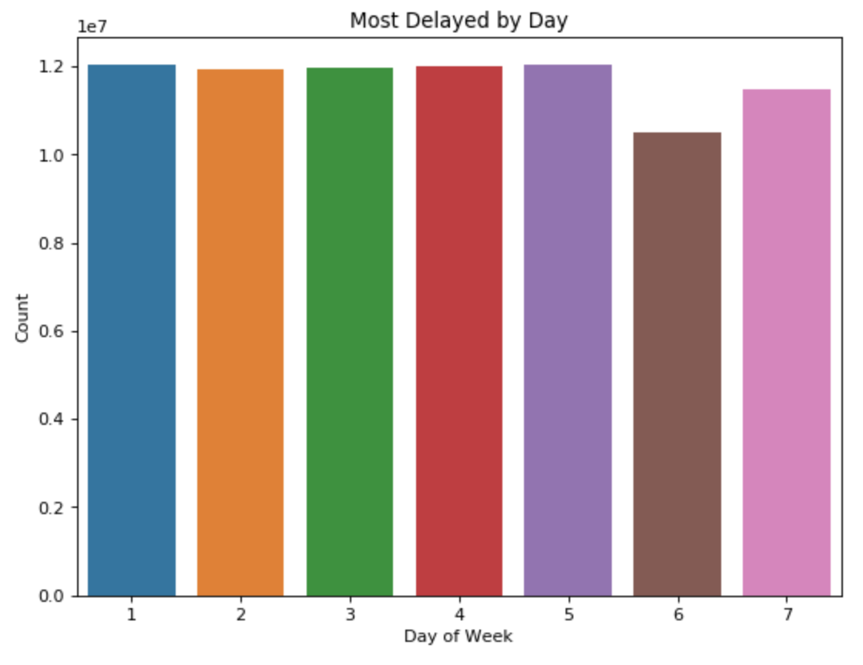
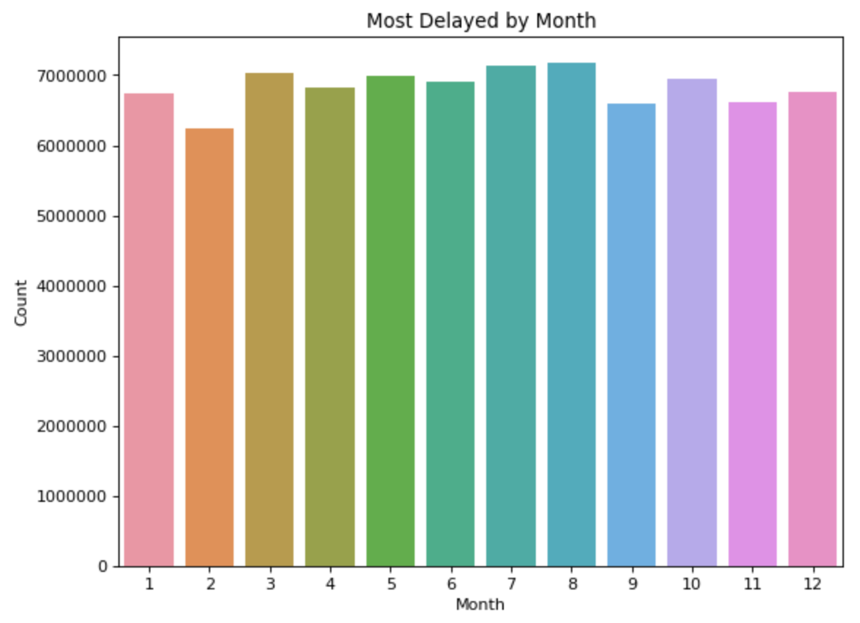
EDA - Delay Analysis - Time
Most delayed flights by Time:
Weekdays see more delays than weekends
Summer days has more delays followed by winter
Notes:
Summer days showers so delay while winter might see more extreme weather so cancel

Slide 18
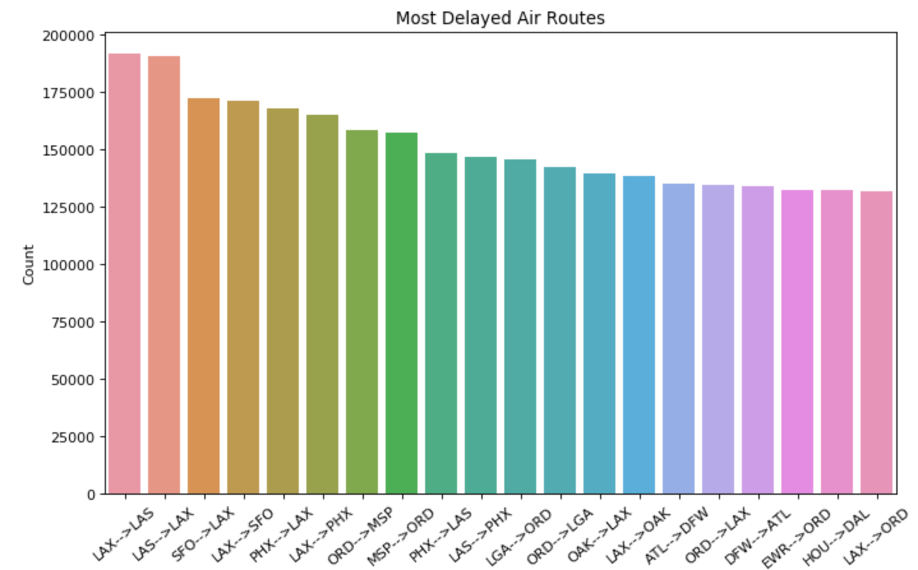
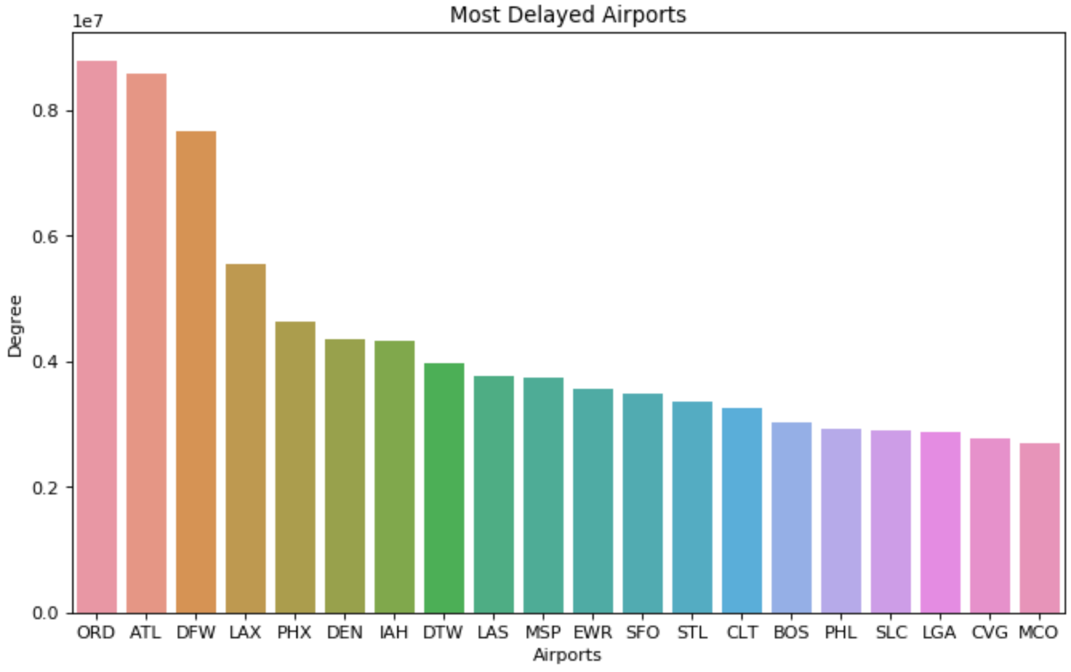
EDA - Delay Analysis - Airports
Cancelled flights by Airport:
LAX to LAS is most delayed route both direction followed by SFO to LAX
ORD most delayed airport followed by ATL
Flights delays are also often bi-directional
analyze delayed flights in detail

Slide 19
EDA - Delay Analysis
Weather and NAS delays lead to longest delay times
Arrival delay and Departure delay are highly correlated
Weekdays see more Delays than weekends like cancellations
Summer flights more likely to delay and winter days following
LAX to SFO, LAS flights has most delays but ORD has most delays inbound and outbound

Slide 20
Data clean - 1. Drop unnecessary columns
scheduled time columns
plane tail number
cancellation code
scheduled time = actual time - delay
Flight number ≈ tail number
99% null values in the dataset

Slide 21

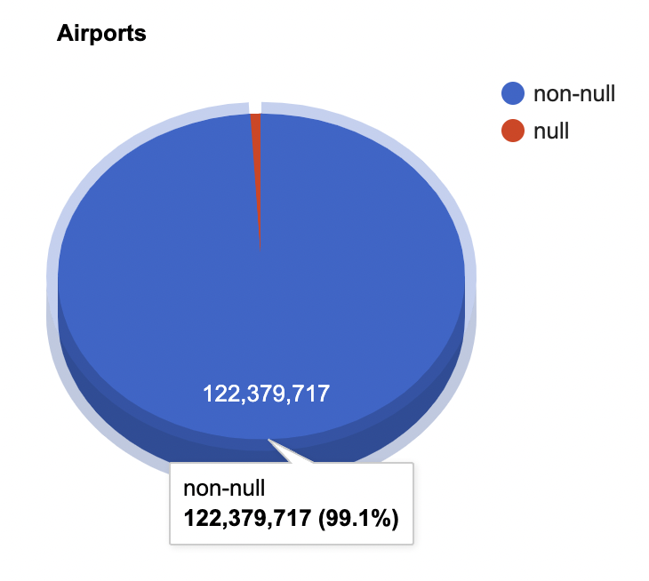
Data clean - 2. airports
Why: Origin airport and destination airports shouldn’t be null.
How: remove rows without airport information

Slide 22

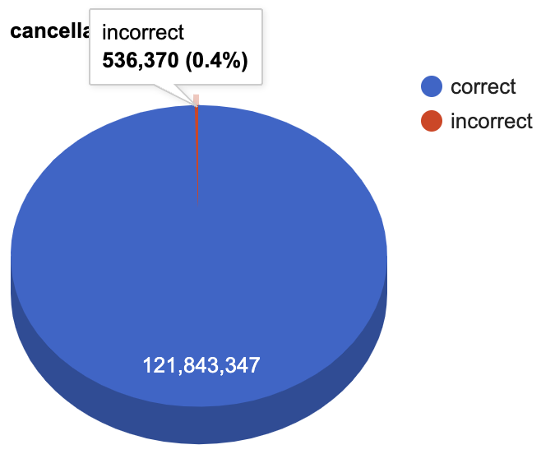
Data clean - 3. cancellation
Dataset with cancellation = 1
Any time-related column should be null
Drop rows with non-null values in those columns
2. Dataset with cancellation = 0
Any time-related column shouldn’t be null
Drop rows with null values in those columns

Slide 23
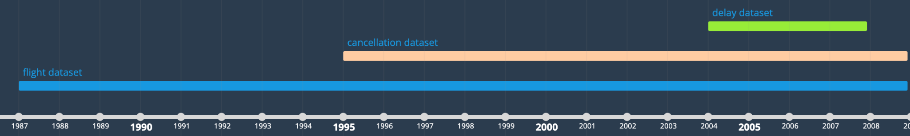
Split the dataset
“flight” | The clean dataset from 1987 to 2008
“cancellation” | The dataset from 1995 to 2008 which exclude all missing values except for values in delay columns
“delay” | The dataset from 2004 to 2007 which exclude all missing values

Slide 24
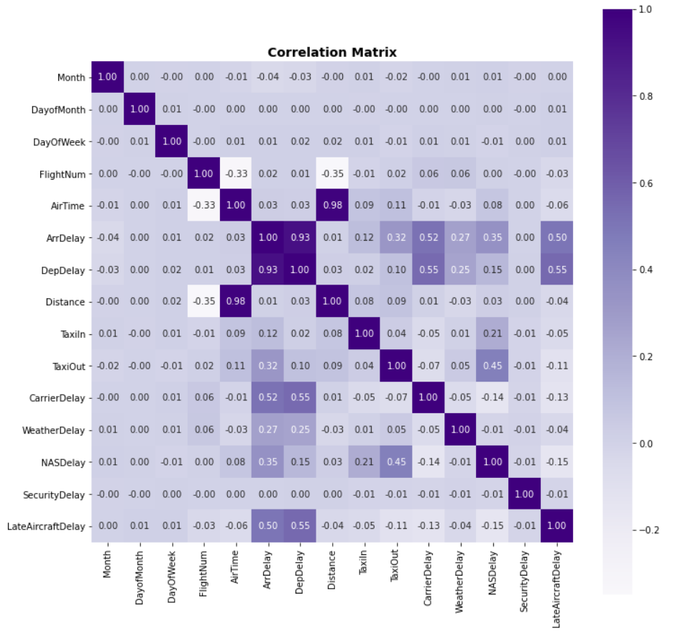
Correlation Analysis
df1995:
Distance ~ Air Time : 0.98
Arrival delay ~Departure delay : 0.93
Taxiing Time ~ delays
Delay reasons ~delays
Notes:
Taxi: move slowly along the ground before takeoff or after landing

Slide 25
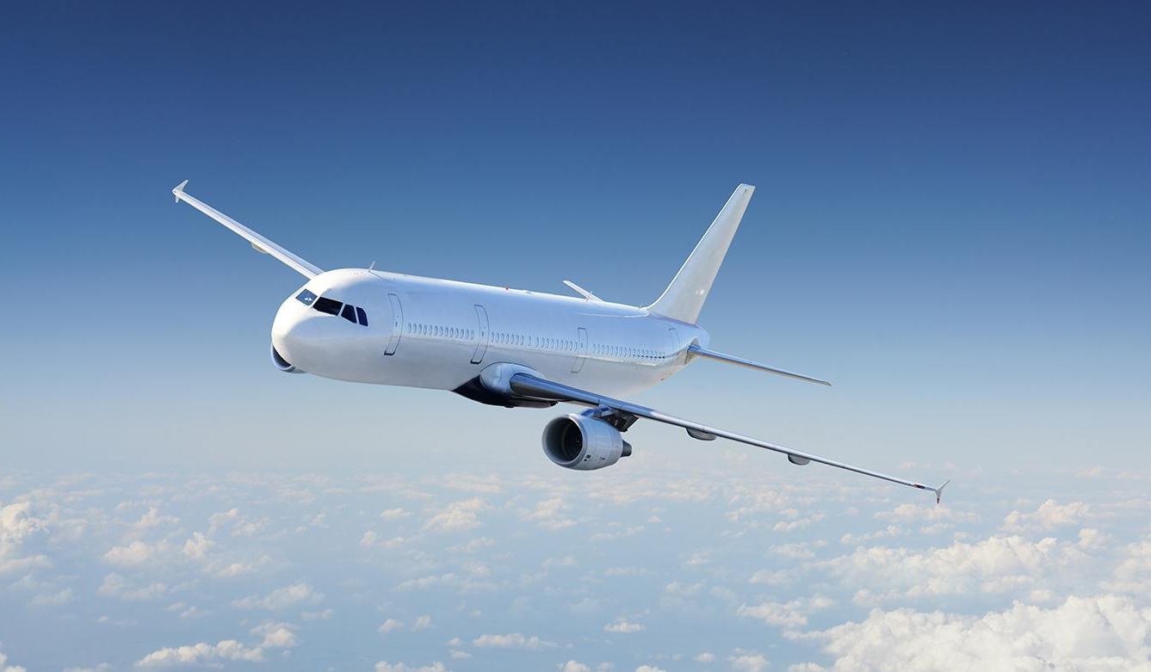
Modeling
We use 80% of the sample as training data, 20% of the sample as testing data

Slide 26
Topic I: Predict If Flights Are Cancelled Or Not
Features:
Year
Month
Day of Month
Day of Week
Unique Carrier
Origin
Destination
Distance
Dataset:
“cancellation”
Method:
Undersampling: randomly select 1% of non-cancelled flights
Vector Assembler: put all features into one feature vector column
Model:
Logistic Regression
Random Forest

Slide 27
Topic I: Model Comparison
 | Logistic Regression | Random Forest
Accuracy | 0.6631 | 0.8963
F1 Score | 0.7941 | 0.9419
AUC Score | 0.6251 | 0.5642

Slide 28
Topic II: Predict Time Of Arrival Delay Each Flight
Dataset:
“delay”
Model:
Random Forest
Gradient Boosting
Features:
Year
Month
Day of Month
Day of Week
Departure Hour
Arrival Hour
Unique Carrier
Origin
Destination
Distance
Diverted
Carrier Delay
Weather Delay
NAS Delay
Security Delay
Late Aircraft Delay

Slide 29
Topic II: Model Comparison
 | Random Forest | Gradient Boosting
RMSE | 27.8331 | 27.1942
MAE | 12.6415 | 12.5401
R-Squared Score | 0.4537 | 0.4785

Slide 30
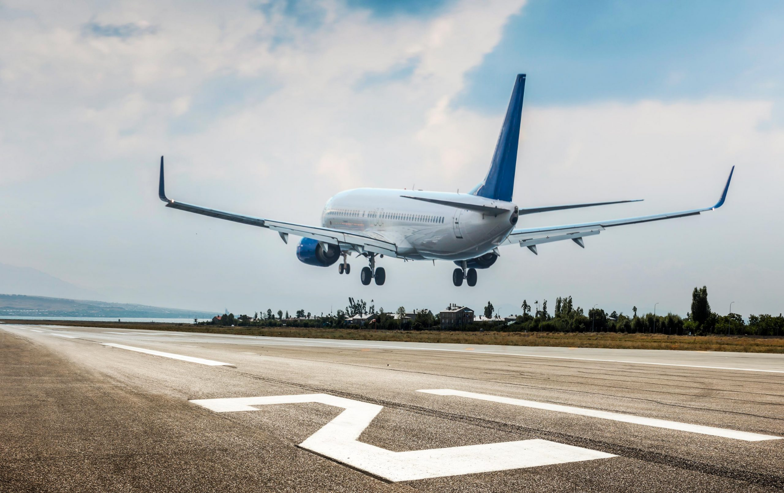
Conclusion

Slide 31
Conclusion
Flights are more likely to be cancelled on Weekdays/ Winter
Flights are more likely to be delayed on Weekdays/ Summer
ORD airport has the most cancellation and delay
LAX-SFO flight has the most cancellation and delay
It is difficult to predict cancellations and delays by flight information

Slide 32
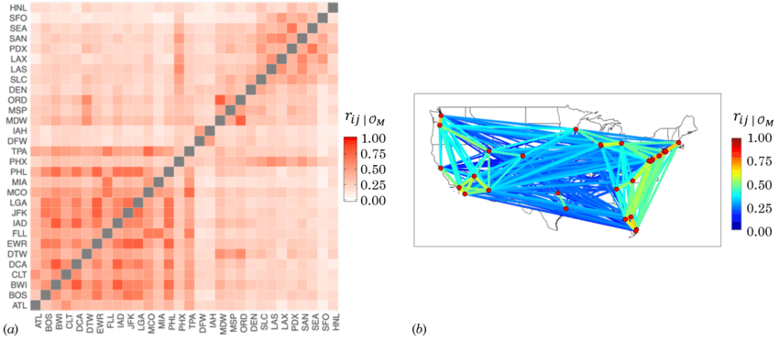
Future Study
Use graph to show spatial distribution and correlation of delays across a network of airports
Deriving insights of delay dynamics of individual airline sub-networks as well as overall network
Network-wide spectral analysis of air trac delays
Quantification of the impacts of various disruptions on the airline systems
https://www.researchgate.net/figure/a-Heat-map-displaying-the-delay-correlation-between-the-top-30-airports-b_fig2_350084821
Notes:
(a) Heat map displaying the delay correlation between the top 30 airports;
(b) Correlations shown with geographical context. Higher correlations are also emphasized with wider lines in (b). Note that HNL is not shown in (b) for simplicity.

Slide 33
THANK YOU!

